Slide 1
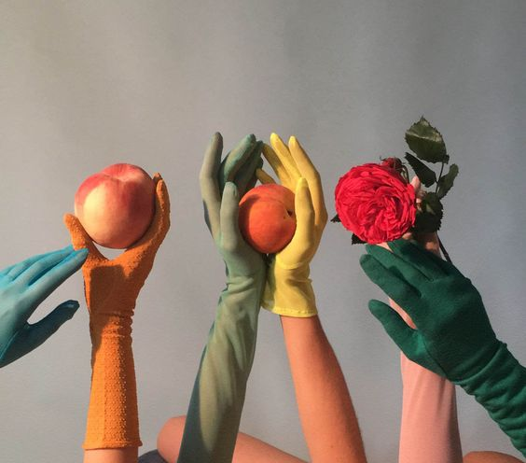
Ziggy and Leaf
Ziggy and Leaf
✽
Marketing Company
Georgia Rogers
Logo

Slide 2
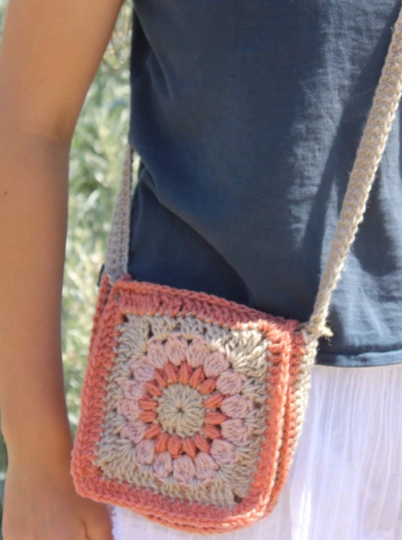
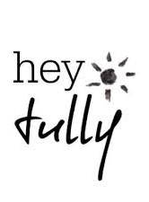
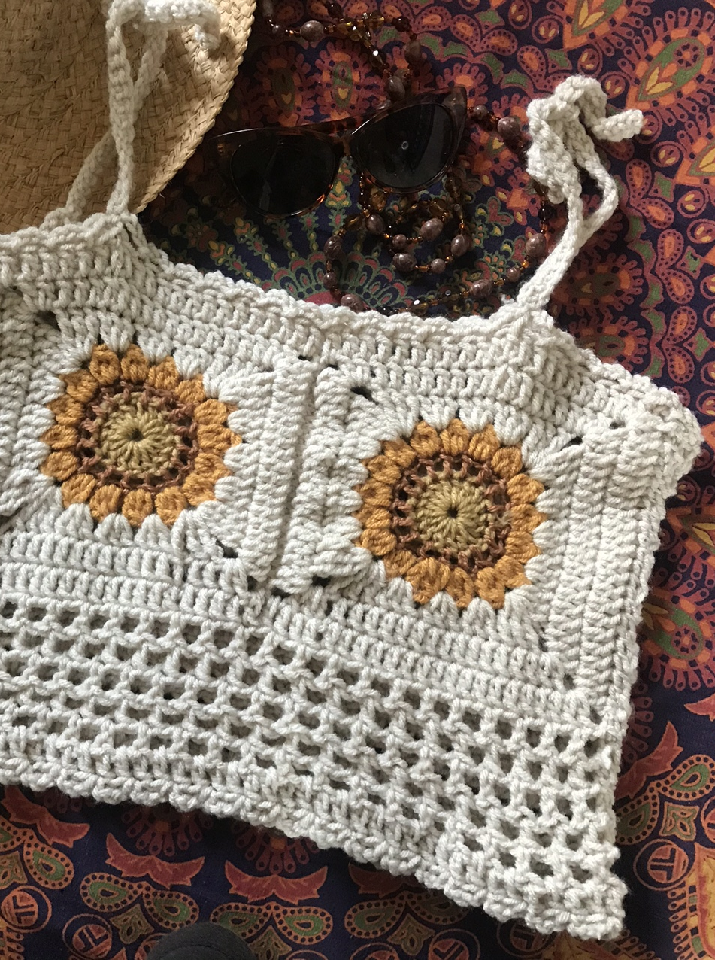
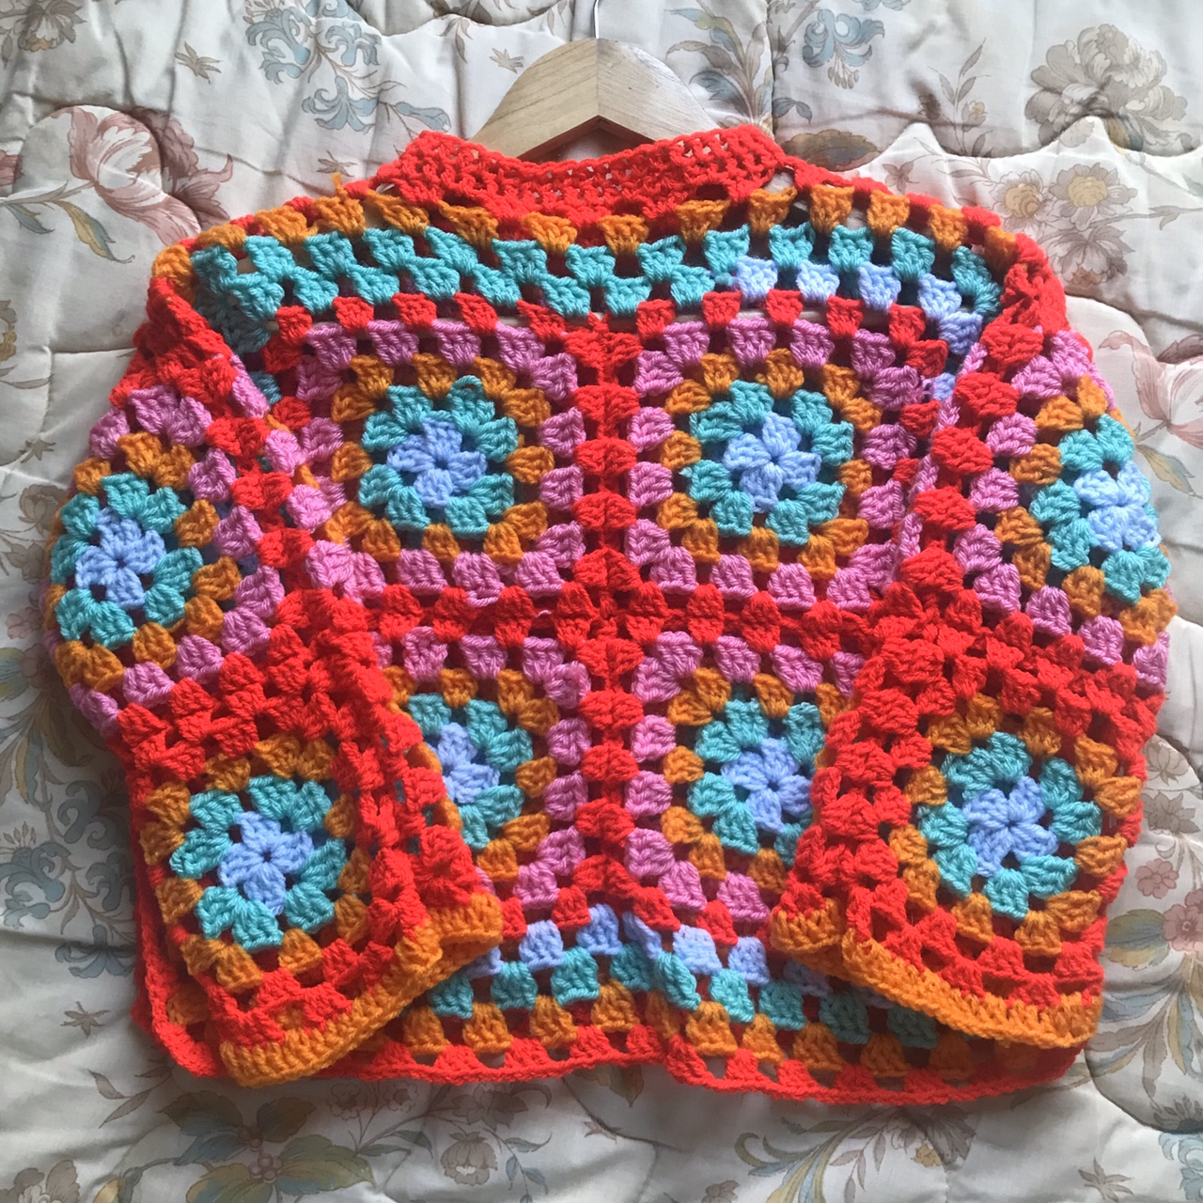
Product
‘Heytully’ is an Australian ethically friendly clothing store using sustainably sourced repurposed materials. Handmade by the designer with love, these groovy garments are guaranteed to make you feel your very best!
The ‘Heytully’ Granny square crochet sweater, (shown in left image), radiates optimism and is perfect for any weather. This is an essential for every environmentally conscious person!

Slide 3
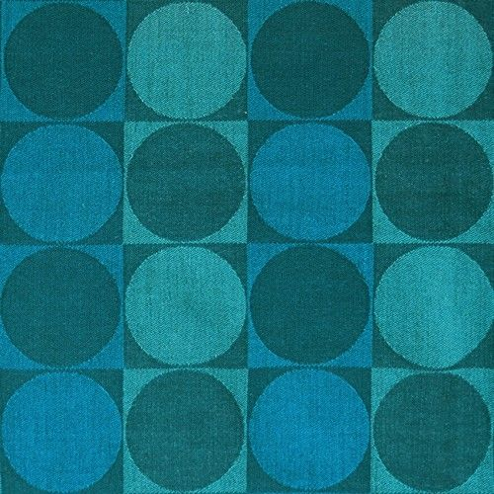
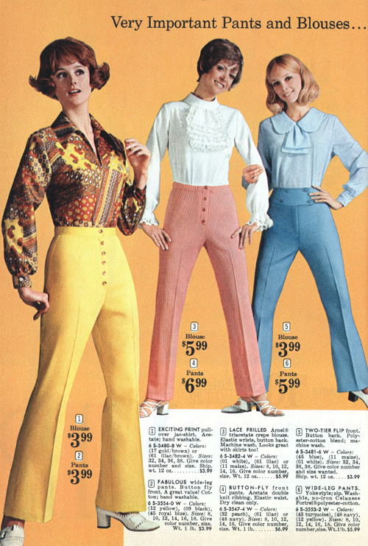
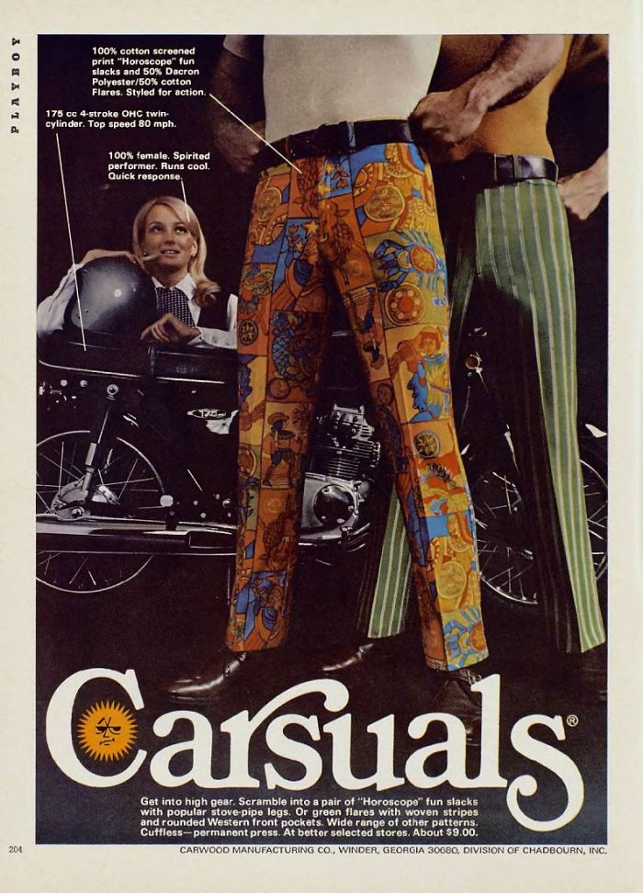
Methods of appeal
✽Fun
✽Colour
✽Excitement
By using a sense of fun and excitement in the advertisement, it enables the consumer to feel that if they purchase the product, they too will experience the happiness and relish in the joy that comes from owning it.
The colours used throughout the advertisement would be bright and playful, adding to the excitement and appealing to the target audience. The colours also contribute to the advertisement coming across as optimistic and youthful.

Slide 4
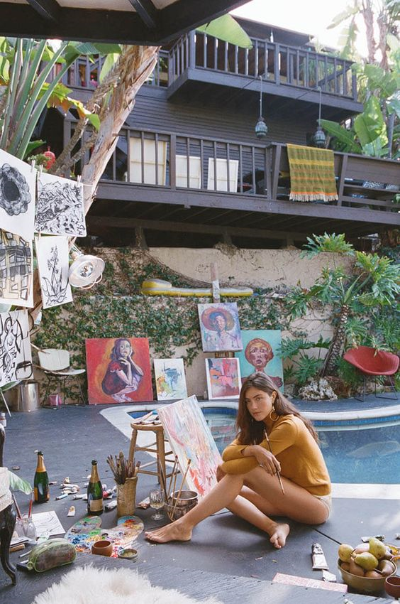
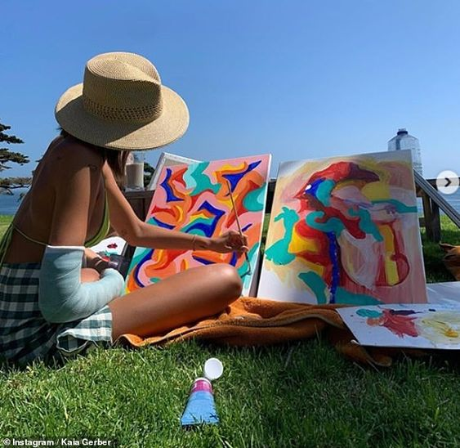
Audience breakdown and brand association
Ziggy and Leaf
✽
The target audience for this product are environmentally conscious, middle class women, aged between 16 and 25, however, it may also appeal to people outside the age bracket. This audience is not afraid to spend money on buying handmade quality items as they see it as an investment in eco-friendly, long lasting clothing.
You will find these funky women strolling along the beach or hanging anywhere outdoors, including waterfalls and rainforests. They are often seen at local farmers markets, searching the aisles at op shops, with friends, reading books or being creative.
These girls are not afraid of being ‘out there’ when it comes to their style, but instead wear things that make them happy. They are extroverted, optimistic and entrepreneurial, going against what is seen as normal.
They enjoy music, the arts and nature, with a passion for environmental justice, which they share on their social media accounts. These women have social media to keep up to date on their friends and favourite artists and activists, however, do not feel the need to be constantly online. These ladies live along the coast of Australia or in Melbourne.

Slide 5
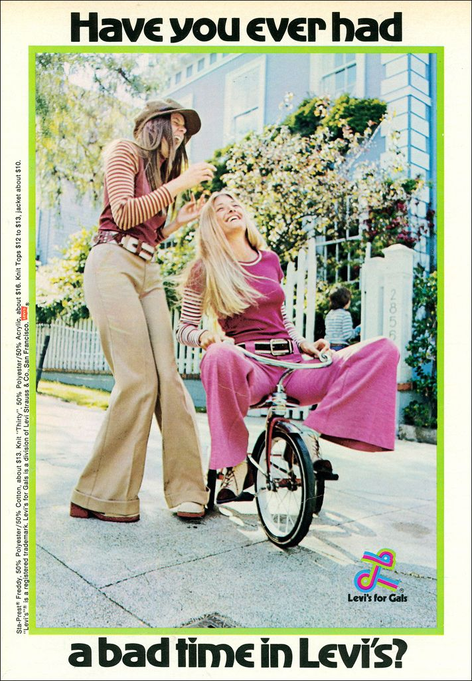
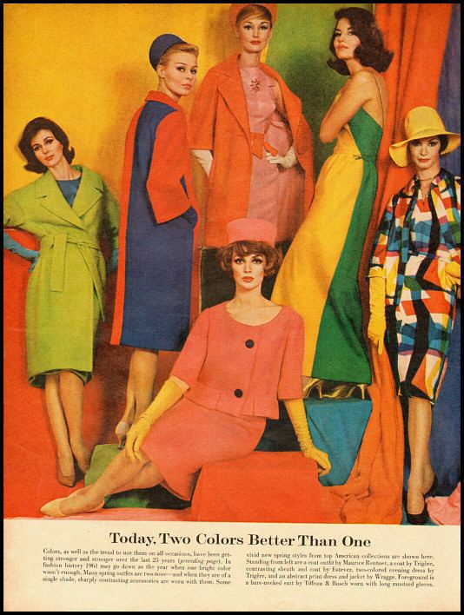
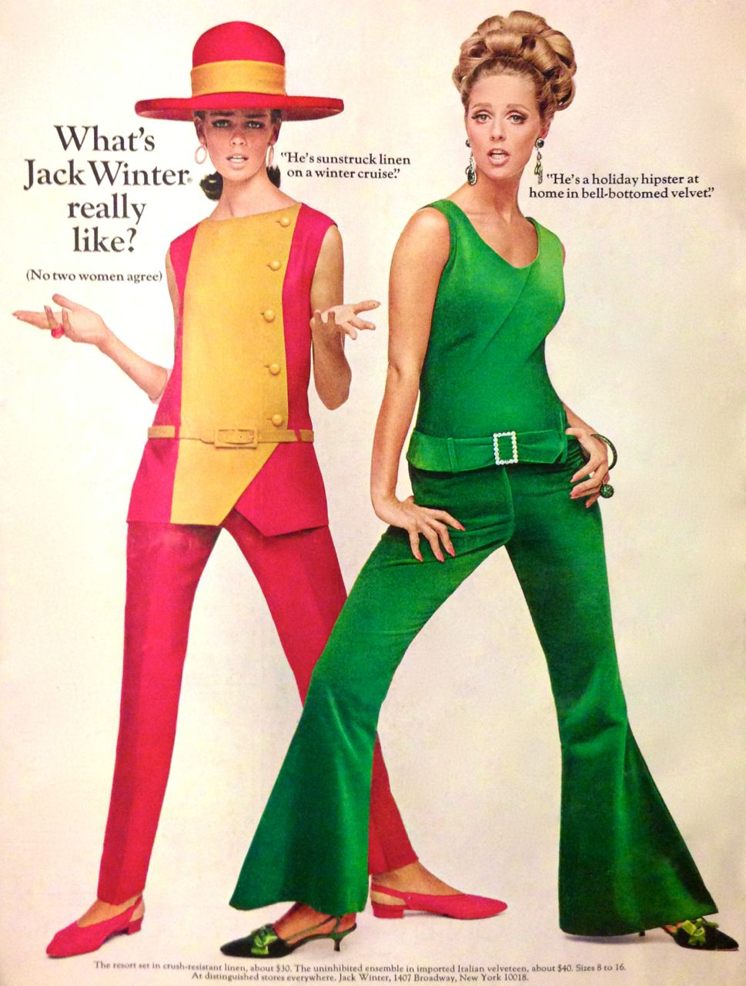
Codes and conventions of advertising
For our advertisement, its important we spark meaning and engage our audience.
By using Heytully’s bright and enthusiastic clothes mixed with the setting of the images and colours used throughout the advertisement, the audience will immediately link the product with fun and excitement, furthering their want of buying the ‘Granny Square Crochet Sweater’.
The headlines, text and captions will be in an inviting and upbeat style, contributing the overall light and enjoyable feeling of the advertisement.
The lighting throughout the picture will be light and bright, making the clothes vibrant and desirable for the audience.
Codes and conventions
Advertisement examples and inspirations

Slide 6
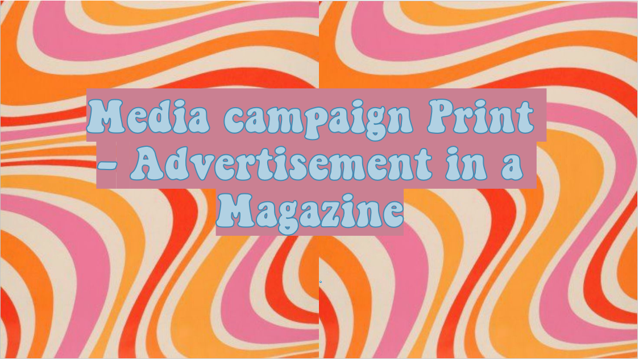
Media campaign Print - Advertisement in a Magazine

Slide 7
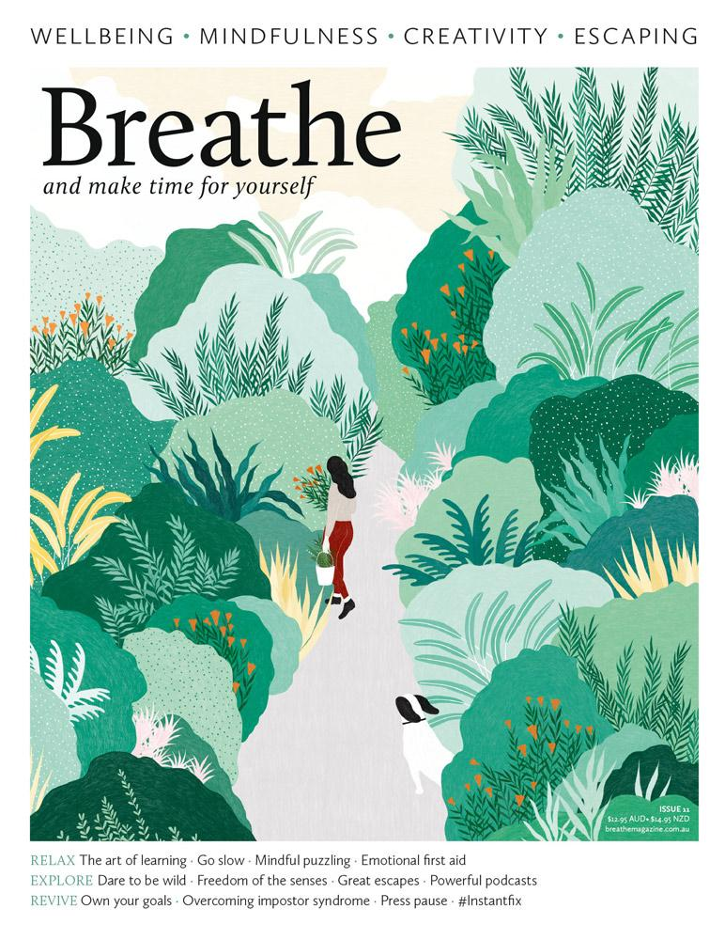
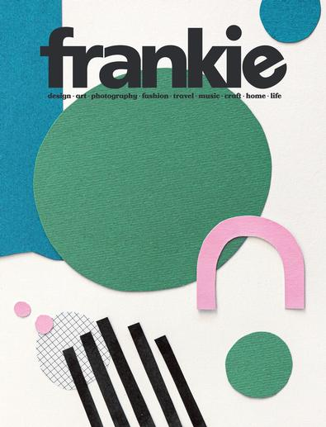
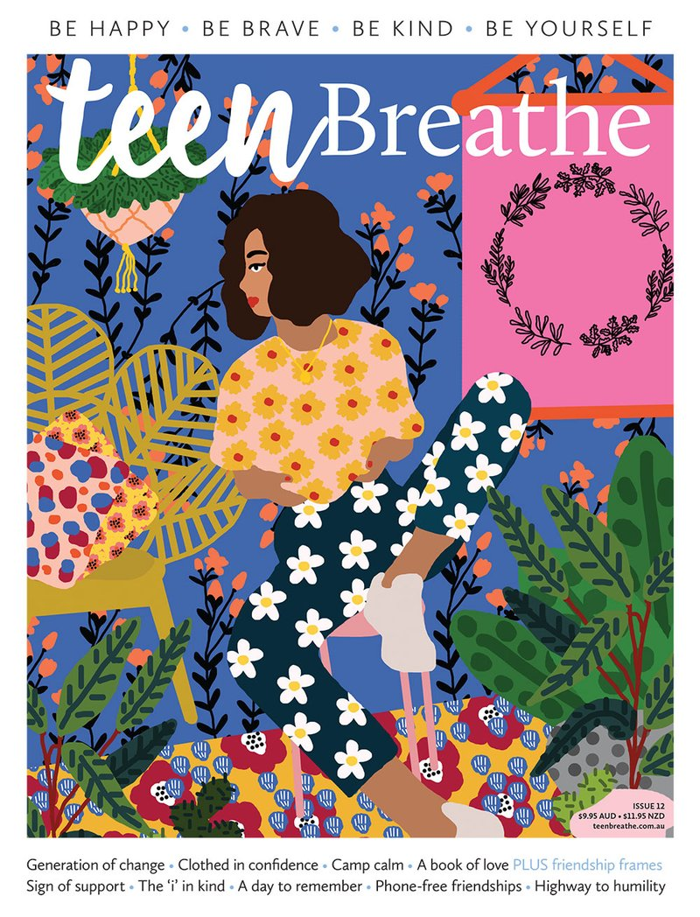
Media Buyer
We plan to advertise in Frankie Magazine, Breathe magazine and Teen Breathe Magazine. In Frankie, we will have the advertisement on a full page, roughly in the middle of the magazine for three editions. In Teen Breathe, the advertisement will be a full page on the cover of the magazine and in Breathe, there will be a full page in the center of the magazine for two editions. By doing this we can ensure the page is bright and colourful enough to draw attention, as well as being throughout the magazine so people see it while they are reading. The Teen Breathe page is at the back of the book as then people have a higher chance of seeing the ad when looking at the magazine in stores.

Slide 8
Advertising rate cards
To the left you can see the print advertising rate card for Frankie Magazine. Although I was unable to find any for Breathe or Teen Breathe magazine, both Frankie, Breathe and Teen Breathe have similar audiences and are both similar aesthetics so assuming that, it should be of similar rates.
According to Frankie Magazines website, 70% of readers have purchased something after seeing it in Frankie and 94% of the audience has visited a website after seeing it in Frankie.
3 x Full page ads for Frankie = (5140 x3) $15,420
1 x outside back cover for Teen Breathe = $8380
2 x full page for Breathe = $10820
Grand total = $34620
We have decided to prioritize Frankie Magazine advertising as their statistics are promising and the audience for the brand is very likely to enjoy Heytully’s products.

Slide 9
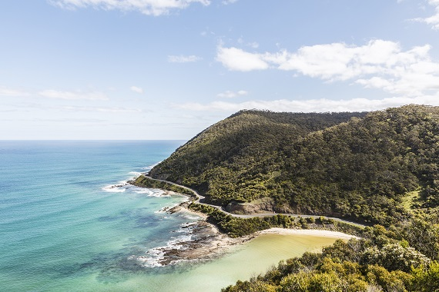
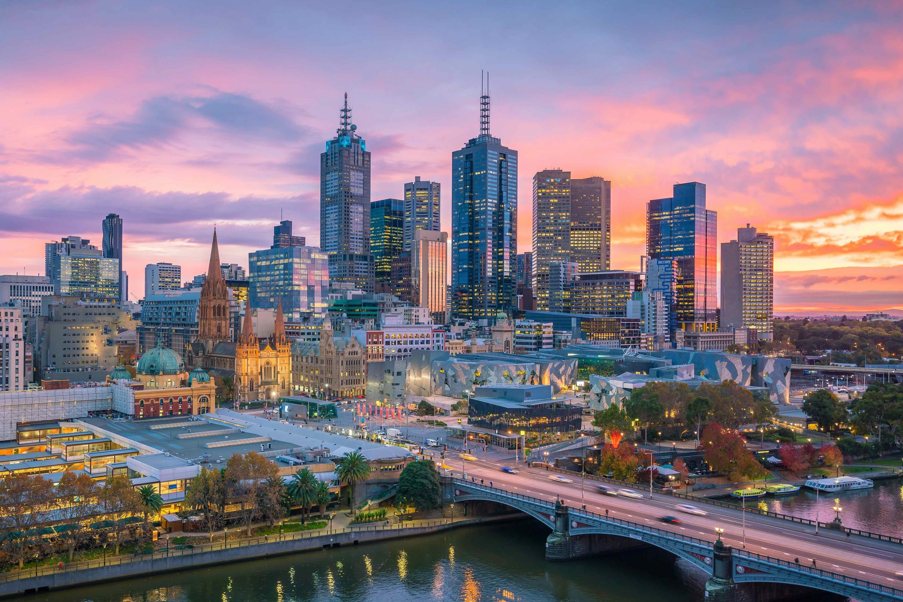
Product Placement
We plan to launch our campaign at the start of December in Melbourne and the Surf Coast. The reason for the time and place is that, because it is before Christmas, people are looking out for gifts and clothes for warmer weather, and the Heytully sweater is perfect for both of those!
We estimate that Melbourne would be an optimal place for the launch as it has many creative young people who fit our demographic, and a large population, so more people would see it. The Surf Coast would be a great choice also, as our audience mostly lives around the area and it is a popular holiday destination so we would have more coverage.

Slide 10
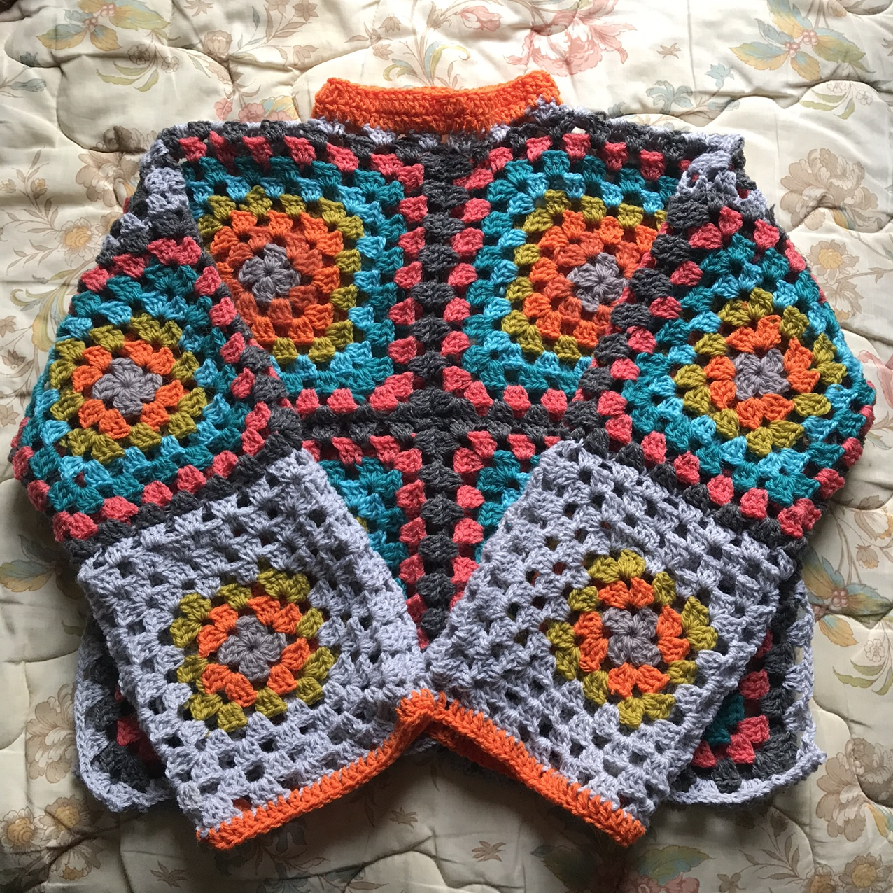
Marketing, research and Evaluation
COOL HUNTING
✽ We believe cool hunting would be an effective strategy as our brand relies on keeping up to date with the trends of our target audience. Cool hunting allows us to make observations and predictions on the latest styles for fashion surrounding our audience, which in turn enables us to develop better products, tailored specifically for our consumers.
BRAND ATTRIBUTE RESEARCH
✽ Brand attribute research is very important as we want the audience to view our product as reliable and something that aligns with their values. To be able to gage an understanding into their thoughts around our product would be very helpful as we would be able to improve our brand to better suit the buyers. We would like the brand to come across as fun, environmentally conscious and a quality product, so insight would be very beneficial.

Slide 11
Budget
Actual Advertisement - $34,620
Cool Hunter - $2,500
Photographer (https://fash.com/costs/photographer-prices) – $500
Photo Editor and Advertisement Layout Manager – $500
Brand Attribute research - $1,400
Hair and makeup - $250
Catering - $250
Stylist - $250
Actresses - $1,200
GRAND TOTAL - $41,470

Slide 12
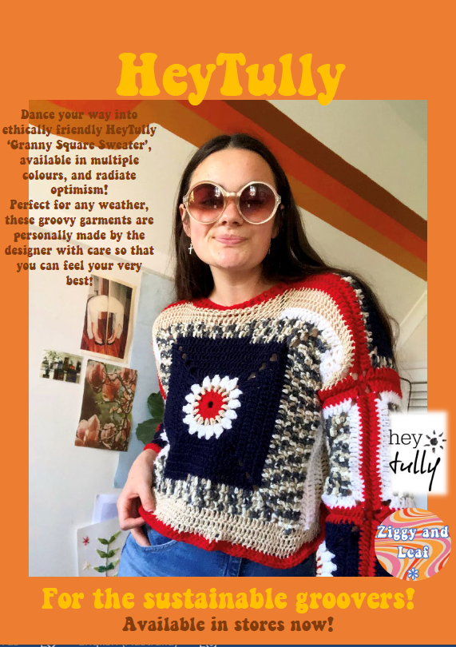
This will be what the advertisement looks like in the magazines.
Next slide shows an example in a Frankie Magazine.
I'm not sure why is turned out slightly blurry, sorry, it wasn’t while I was making it.

Slide 13
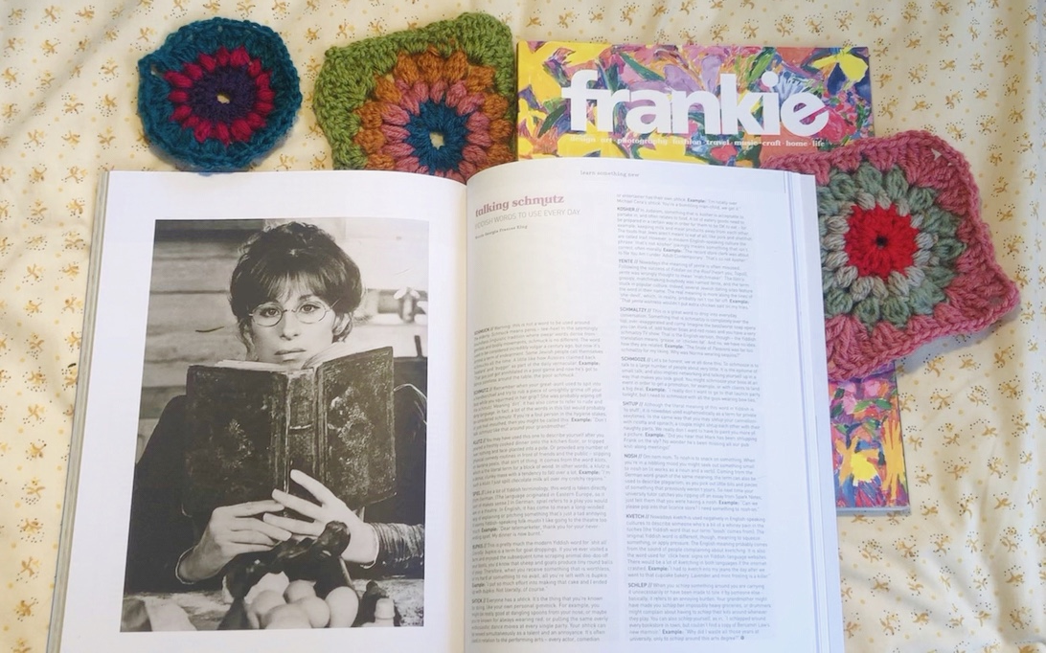
Sorry, this is really badly done! You get the picture though.

